Slide 1
Advanced Financial Misinformation Detection system using AI, LLM and Data Providers
PIP2001 Capstone Project
Review-1
Batch Number: PSC188
Student Name | Roll Number
SM SUHAIL AHAMED | 20211CCS0101
PREETHI T K | 20211CCS0105
RUSHIL BHARDWAJ L | 20211CCS0118
SIMRAN JOGI | 20211CCS0150
MOULYA Y G | 20211CCS0166
Under the Supervision of,
Dr. Shakeera L
Professor
School of Computer Science and Engineering
Presidency University
Name of the Program: B.Tech Computer Science Engineering (Cyber Security)
Name of the HoD: Dr. Ananda Raj S P
Name of the Program Project Coordinator: Dr. Sharmasth Vali Y
Name of the School Project Coordinators: Dr. Sampath A K / Dr. Abdul Khadar A / Mr. Md Ziaur Rahman

Slide 2
Introduction
Problem Statement : Financial Misinformation Detection System
The emergence of financial misinformation presents a significant challenge for investors, financial institutions, and regulatory bodies.
Misinformation can mislead investors, distort market dynamics, and ultimately lead to financial losses and decreased market integrity.
This problem is exacerbated by the rapid dissemination of information through social media, news platforms, and online forums, where inaccurate or misleading claims can gain traction quickly.

Slide 3
Literature Review
Paper Title | Paper Author | Techniques Used | Merits | Demerits
FMDLlama: Financial Misinformation Detection based on Large Language Models | Authors: FMDLlama team Published on: arXiv | Fine-tuning LLaMA2 and Llama3 models with instruction-tuning datasets; evaluated with financial misinformation detection tasks | High accuracy for detection tasks, especially using ChatGPT and FMDLlama3, showing superior performance | Resource-intensive; requires large computational power and memory for model training
Evaluating Large Language Models for Fake News Detection | Authors: Koka, S., Vuong, A., & Kataria, A. Published on: arXiv, June 2024 | GPT-4, Claude, Gemini Pro | High accuracy in news contexts | High computation costs, lack of real-time responsiveness

Slide 4
Paper Title | Paper Author | Techniques Used | Merits | Demerits
A Comparative Study of LLMs and Offline Models in Fake News Detection | Authors: Hu, W., Li, S., & Wang, M. Published on: arXiv, Sept 2024 | GPT-3.5, FactAgent, Multimodal Approaches | Effective multimodal performance across platforms | Static datasets limit real-time misinformation detection
Fake News Detection using Deep Learning Algorithms | Authors: Sadia, H., Ahmed, M., & Khan, N. Published on: Springer, 2023 | NLP, BERT, LSTM models | High detection rates for text-based financial fake news | Requires high-quality data, sensitive to adversarial attacks

Slide 5
Paper Title | Paper Author | Techniques Used | Merits | Demerits
Misinformation Detection on Social Media: A Review | Authors: Chauhan, D., Patel, R., & Chauhan, S. Published on: IEEE Xplore, 2023 | Machine learning, Hidden Markov Models | Fast misinformation detection across platforms | Difficulty in identifying deepfakes
Fake News in Business and Financial Management | Authors: Islam, M. S., & Rajamma, R. Published on: Emerald Insight, 2022 | Knowledge-based and ML approaches | Extensive business domain-specific knowledge integration | Limited generalizability across sectors

Slide 6
Paper Title | Paper Author | Techniques Used | Merits | Demerits
Disinformation in Financial Markets: A Case Study | Authors: Wu, X., & Lee, J. Published on: Harvard Kennedy School, 2021 | Social Network Analysis, SVM | Shows social media's effect on financial market manipulation | SVM struggles with nuanced or fast-spreading information
Fake News Detection in Financial Markets: A Deep Learning Approach | Authors: Islam, M. S., & Hossain, M. Published on: ACM Digital Library | CNN, Transformer-based Models | High accuracy on labeled financial datasets | Limited ability to generalize beyond tested financial markets

Slide 7
Paper Title | Paper Author | Techniques Used | Merits | Demerits
The Role of LLMs in Fighting Financial Misinformation | Authors: Meel, P., & Vishwakarma, D. K. Published on: arXiv, 2022 | GPT-3, BERT | Proves scalability and general applicability to various news domains | Underperformance in low-resource languages and domains
Fake News Detection using Multimodal Learning | Authors: Kim, H., & Park, J. Published on: Springer, 2021 | Multimodal Deep Learning, NLP | Effective detection of both text and image-based misinformation | Requires significant computational power and large datasets

Slide 8
Objectives
Bug free application
Accurate misinformation detection system
Accurate news clipping
Fast and efficient
Should handle multiple queries
Accurate stock market predictions

Slide 9
Existing Methods
Large Language Models (LLMs) for Financial Misinformation Detection
Multimodal Approaches
BERT and Transformer-Based Models
Social Network Analysis and Support Vector Machines (SVMs
Deep Learning Approaches (CNN, LSTM)
Fact-Checking with Knowledge-Based Models
Misinformation Detection using Hidden Markov Models (HMMs)

Slide 10
Existing method Drawback
High computational cost
Requires large datasets
Complex model integration
Energy consumption issues
Low real-time efficiency
Difficult model interpretability
Scalability limitations
Data privacy concerns
Overfitting risks
Embedding bias risks

Slide 11
Proposed Method
Name : Advanced Financial Misinformation Detection system using Artificial Intelligence, LLM and Data Providers.
The proposed system consists of a modular architecture divided into four main components:
1. Data Acquisition Module
2. Data Processing and Analysis Module
3. Stock Market Predictions
4. Accuracy Assessment Module
5. Output Generation Module

Slide 12
Methodology/Modules
Data Acquisition Module: LLM, OpenAI, Yahoo Finance
Data Processing and Analysis Module: LLM
Accuracy Assessment Module: Standard
Output Generation Module: Streamlit
Stock Market Prediction: LSTM, XGBoost

Slide 13
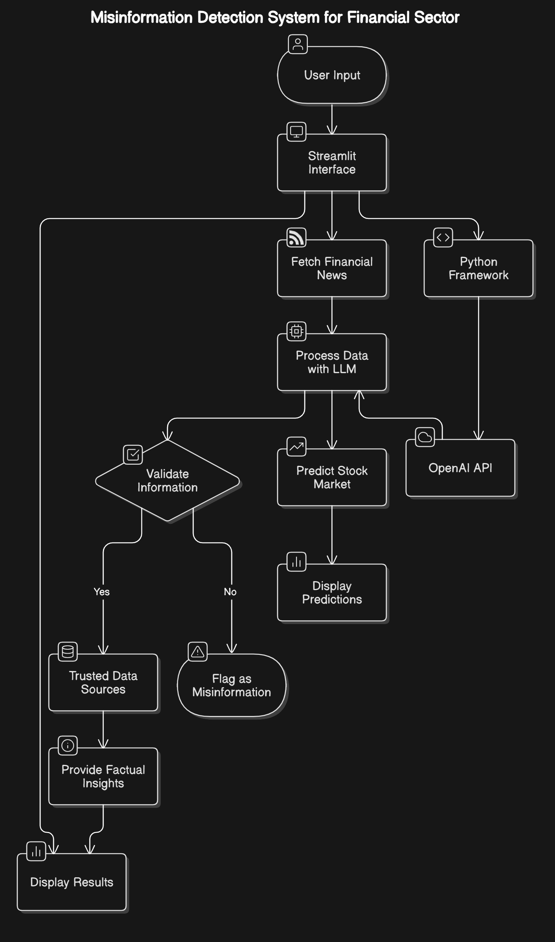
Architecture

Slide 14
Hardware/software components
Hardware Requirements
Processor: Intel Core i7 or above (minimum quad-core)
RAM: 16 GB (32 GB preferred for faster processing)
GPU: NVIDIA Tesla K80 (or any other CUDA-enabled GPU for deep learning tasks)
Storage: 100 GB of free disk space for dataset, model weights, and logs
Software Requirements
Operating System: Linux or Windows 10+
Programming Language: Python 3.8 or above
Development Tools:
Visual Studio Code with Python Environment
Libraries:
OpenAI API (for handling the requests/queries)
Streamlit (for handling the front end)

Slide 15
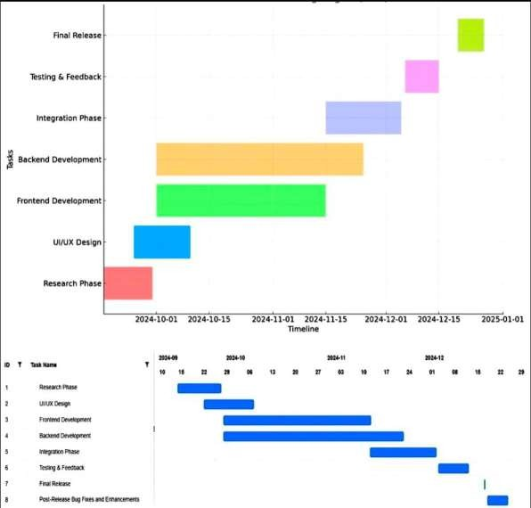
Timeline of Project

Slide 16
Expected Outcomes
Enhanced data accuracy
Improved Financial Decision-Making
Efficient Misinformation Detection
Simplified Data Handling
Selective Information Display
Reduction in Fraudulent Financial Reporting

Slide 17
Conclusion
The application is designed to detect and evaluate the accuracy of information.
By processing the input and checking it with data sources, the system provides an accuracy score, particularly returning a 100% match when the content is entirely factual.
This analysis enables users to understand the credibility of the information, while real-time feedback and validation ensure that any discrepancies or inaccuracies are flagged, offering users the opportunity to correct or verify the data before further use.
This feature makes the application an effective tool for fact-checking and ensuring the reliability of news.

Slide 18
Github Link
The Github link provided should have public access permission.
Github Link
https://github.com/RushilBhardwaj-L/CCS-G08-CAPSTONE-PROJECT

Slide 19
References
^{[1]} Liu, Z., Zhang, X., Yang, K., Xie, Q., & Huang, J. (2024). FMDLlama: Financial misinformation detection using LLMs. Papers with Code. https://paperswithcode.com/paper/fmdllama-financial-misinformation
^{[2]} Koka, S., Vuong, A., & Kataria, A. (2024). Evaluating large language models for fake news detection. arXiv. https://arxiv.org/abs/2402.00000
^{[3]} Hu, W., Li, S., & Wang, M. (2024). A comparative study of LLMs and offline models in fake news detection. arXiv. https://arxiv.org/abs/2401.00000
^{[4]} Sadia, H., Ahmed, M., & Khan, N. (2023). Fake news detection using deep learning algorithms. Springer. https://link.springer.com/chapter/10.1007/978-3-031-15252-3_7
^{[5]} Chauhan, D., Patel, R., & Chauhan, S. (2023). Misinformation detection on social media: A review. IEEE Xplore. https://ieeexplore.ieee.org/document/9745367
^{[6]} Islam, M. S., & Rajamma, R. (2022). Fake news in business and financial management: A systematic review. Emerald Insight. https://www.emerald.com/insight/content/doi/10.1108/978178635732220161004
^{[7]} Wu, X., & Lee, J. (2021). Disinformation in financial markets: A case study. Harvard Kennedy School. https://www.hks.harvard.edu/publications/disinformation-financial-markets-case-study
^{[8]} Islam, M. S., & Hossain, M. (2021). Fake news detection in financial markets: A deep learning approach. MDPI. https://www.mdpi.com/2076-3417/11/10/4489
^{[9]} Meel, P., & Vishwakarma, D. K. (2022). The role of LLMs in fighting financial misinformation. arXiv. https://arxiv.org/abs/2201.00000
^{[10]} Kim, H., & Park, J. (2021). Fake news detection using multimodal learning. Springer. https://link.springer.com/article/10.1007/s11063-021-00583-1

Slide 20

Project work mapping with SDG

Slide 21
Thank You

